Slide 1
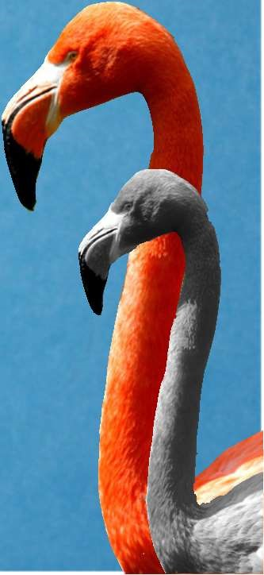
CHAPTER 1
Exploring Data
1.3
Describing Quantitative
Data with Numbers
The Practice of Statistics, 5th Edition
Starnes, Tabor, Yates, Moore
Bedford Freeman Worth Publishers

Slide 2
Describing Quantitative Data with Numbers
Learning Objectives
After this section, you should be able to:
$
CALCULATE measures of center (mean, median).
$
CALCULATE and INTERPRET measures of spread (range,
IQR
,
standard deviation).
$
CHOOSE the most appropriate measure of center and spread in a
given setting.
$
IDENTIFY outliers using the 1.5
×
IQR
rule.
$
MAKE and INTERPRET boxplots of quantitative data.
$
USE appropriate graphs and numerical summaries to compare
distributions of quantitative variables.
The Practice of Statistics, 5
th

Slide 3
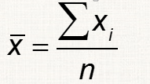
Measuring Center: The Mean

Slide 4
Note: x is the mean of a sample
The mean of the population is μ.

Slide 5
Measuring Center: The Median
Another common measure of center is the
median
. The median
describes the midpoint of a distribution.
The
median
is the midpoint of a distribution, the number such
that half of the observations are smaller and the other half are
larger.
To find the median of a distribution:
1.Arrange all observations from smallest to largest.
2.If the number of observations
n
is odd, the median is the
center observation in the ordered list.
3.If the number of observations
n
is even, the median is the
average of the two center observations in the ordered list.
The Practice of Statistics, 5
th

Slide 6
Find the median:
1 2 3 8
2 0 2 4 4 5 6
3 1 2 4 7 7 8 9
4 0 0 3 5 7 7
5 6 8

Slide 7
Measuring Spread: The Interquartile Range (IQR)
A useful description of a distribution requires a measure of center and a measure of spread.
One such measure is the IQR, which is simply the difference between the first quartile and the third.
Quartiles: Find the observations that are at 25%, Q1, and 75%, Q3. (Note, Q2 would be the same as the median.)
IQR = Q3 - Q1

Slide 8
Find the IQR:
1 2 3 8
2 0 2 4 4 5 6
3 1 2 4 7 7 8 9
4 0 0 3 5 7 7
5 6 8

Slide 9
Examples:
14 observations:
12 observations:
13 observations:

Slide 10
Identifying Outliers
In addition to serving as a measure of spread, the interquartile
range (
IQR
) is used as part of a rule for identifying
outliers.
The 1.5 x
IQR
Rule for Outliers
Call an observation an outlier if it falls more than 1.5 x
IQR
above the third quartile or below the first quartile.
The Practice of Statistics, 5

Slide 11
The Five-Number Summary and the Boxplot
These five numbers divide our data into 4 sets of equal size:
minimum
Q1
median
Q3
maximum
When we look at all five we get a quick summary of the center and spread of our data.

Slide 12
Boxplots (Box-and-Whisker Plots)
finish p. 28
The Practice of Statistics, 5

Slide 13
Boxplots on the calculator
Enter the data into L1
Turn on the Plot (2nd, Y=)
Choose the Boxplot (choose the one that shows the outliers)
Press Zoom, then ZoomStat
Press TRACE to see the 5 number summary
OR Press STAT, then CALC, then choose 1-Var Stats

Slide 14
When asked to compare distributions, you can choose to use
median and IQR OR
mean and standard deviation
The standard deviation is a number that summarizes how far the observations are from the mean.

Slide 15
Measuring Spread: The Standard Deviation
Consider the data displayed below:
x = 5.25
Step 1: For each observation, calculate the deviation from the mean.

Slide 16
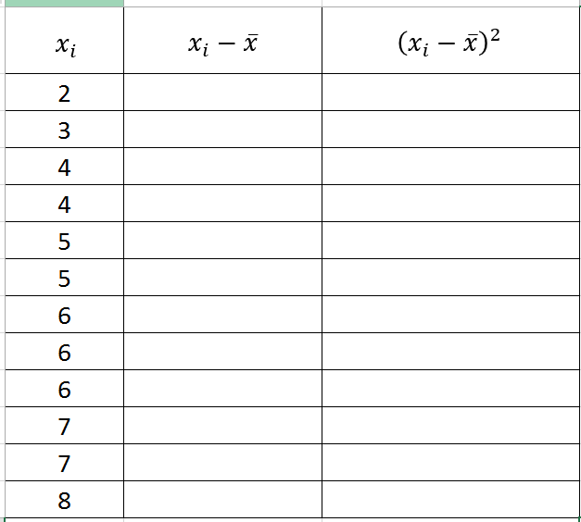

Slide 17
Choosing Measures of Center and Spread
We now have a choice between two descriptions for center and spread
•Mean and Standard Deviation
•Median and Interquartile Range
Choosing Measures of Center and Spread
•The median and
IQR
are usually better than the mean and
standard deviation for describing a skewed distribution or a
distribution with outliers.
•Use mean and standard deviation only for reasonably symmetric
distributions that don’t have outliers.
•NOTE: Numerical summaries do not fully describe the shape of
a distribution.
ALWAYS PLOT YOUR DATA!
The Practice of Statistics, 5
th

Slide 18
Resistance - median is resistant while the mean is not resistant to change
Explain:
What about the IQR and the standard deviation?

Slide 19
In a symmetric distribution, the mean and median will be _____________.
In right-skewed, mean ____ median.
In left-skewed, mean ____ median.
WHY?

Slide 20
Organizing a Statistical Problem
As you learn more about statistics, you will be asked to solve more
complex problems. Here is a four-step process you can follow.
How to Organize a Statistical Problem: A Four-Step Process
•
State
: What’s the question that you’re trying to answer?
•
Plan
: How will you go about answering the question? What
statistical techniques does this problem call for?
•
Do
: Make graphs and carry out needed calculations.
•
Conclude
: Give your conclusion in the setting of the real-world
problem.
The Practice of Statistics, 5
th

Slide 21
Data Analysis: Making Sense of Data
Section Summary
In this section, we learned how to…
$
CALCULATE measures of center (mean, median).
$
CALCULATE and INTERPRET measures of spread (range,
IQR
,
standard deviation).
$
CHOOSE the most appropriate measure of center and spread in a
given setting.
$
IDENTIFY outliers using the 1.5
×
IQR
rule.
$
MAKE and INTERPRET boxplots of quantitative data.
$
USE appropriate graphs and numerical summaries to compare
distributions of quantitative variables.
The Practice of Statistics, 5
th

