Slide 1
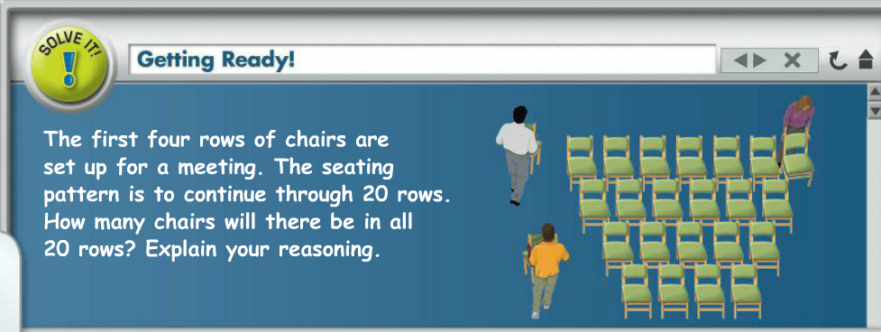

Slide 2
the sum is ???

Slide 3
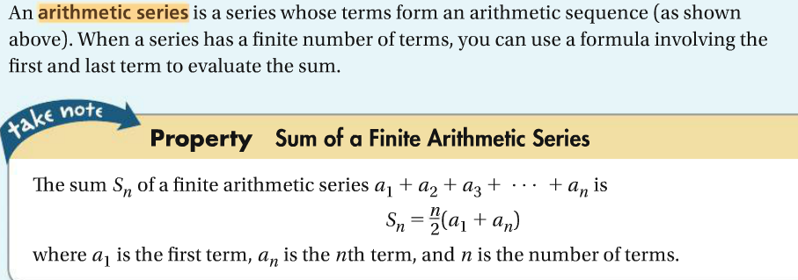
You try: make up your own finite arithmetic sequence and find the sum.

Slide 8
Summation notation:
explicit formula for each term
8
Ʃ
limits
3n-5
n=1
The series:
(3*1-5)+(3*2-5)+...
= -2 + 1 +...
(You finish)

