Slide 1
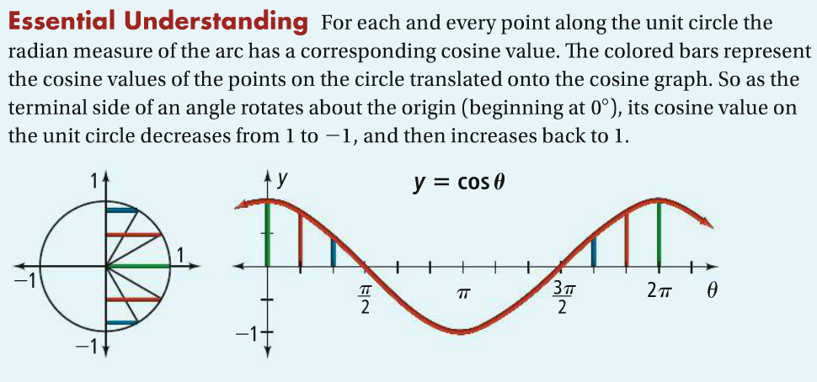

Slide 2
Domain
Range
Period
Amplitude

Slide 3
Domain
Range
Period
Amplitude

